Slide 1
Minnesota PBIS Winter 2019 Training
Cohort 14
MDE PBIS Management Team
October & November 2019
MDE.PBIS@state.mn.us

Slide 2
Takeaways
PBIS in Action
TFI progress & Sustainability
2019 PBIS Leadership Forum
MDE News & Save the Dates

Slide 3
PBIS in Action

Slide 4
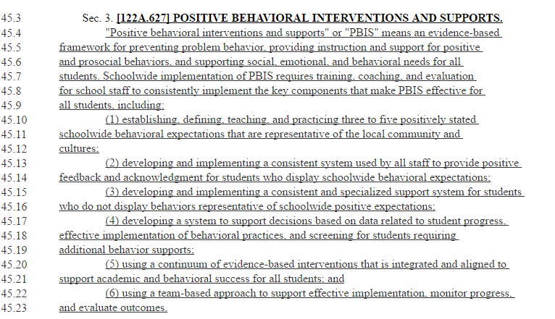
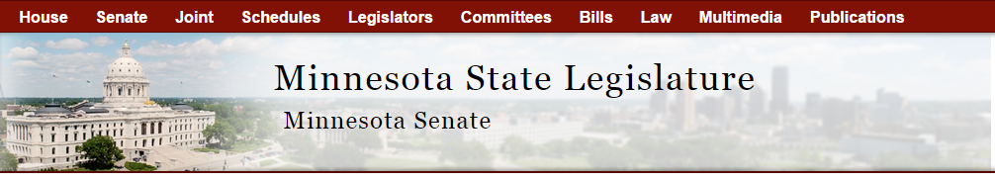
MN Statute 122A.627
Source: https://www.revisor.mn.gov/laws/?id=5&year=2017&type=1#laws.2.26.0
Notes:
What you saw in the bicycle analogy is focused in our MN state statute
6 core points are what you have been trained over in the past 7 days

Slide 5
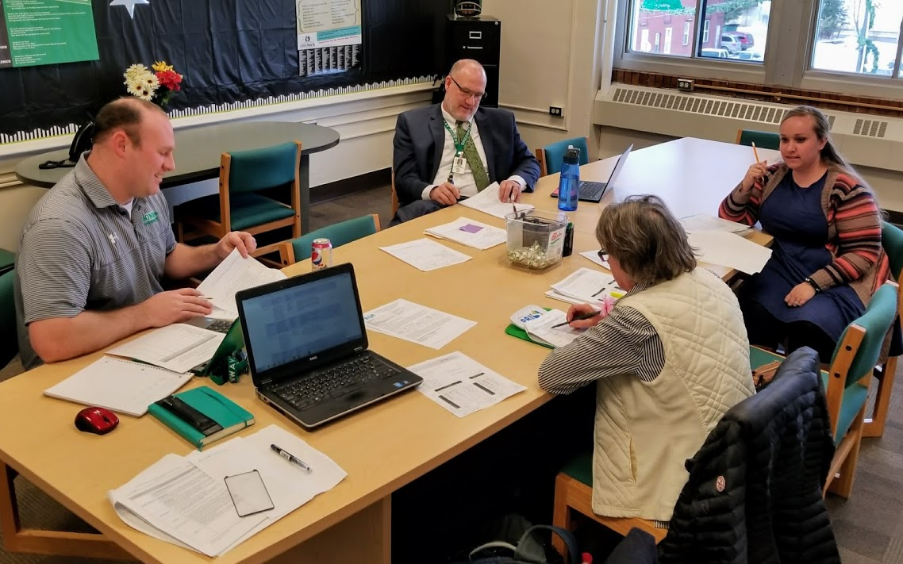
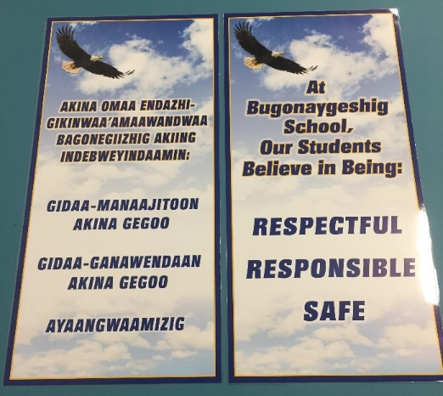
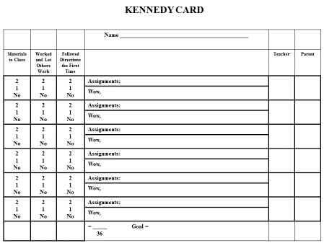
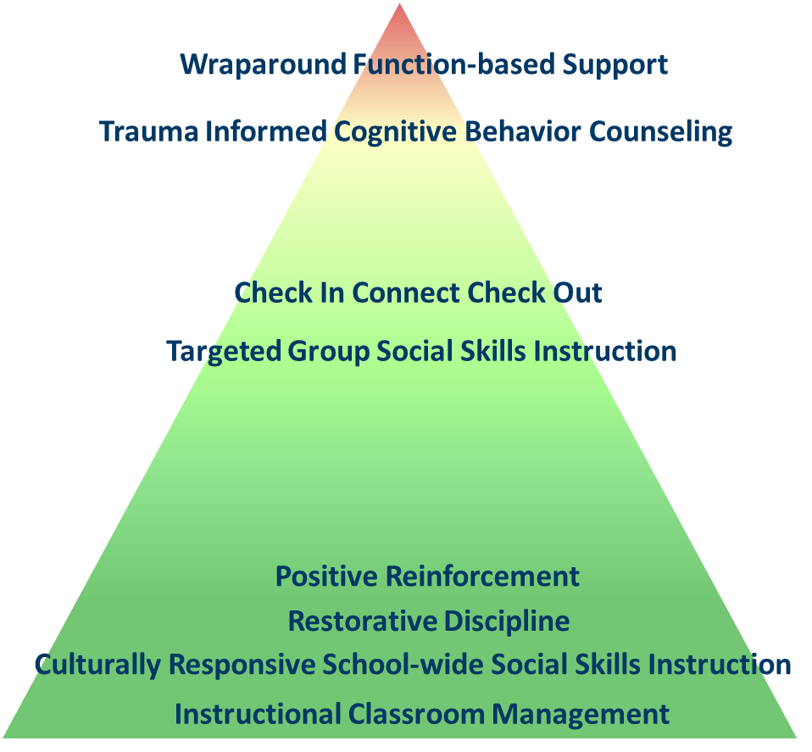

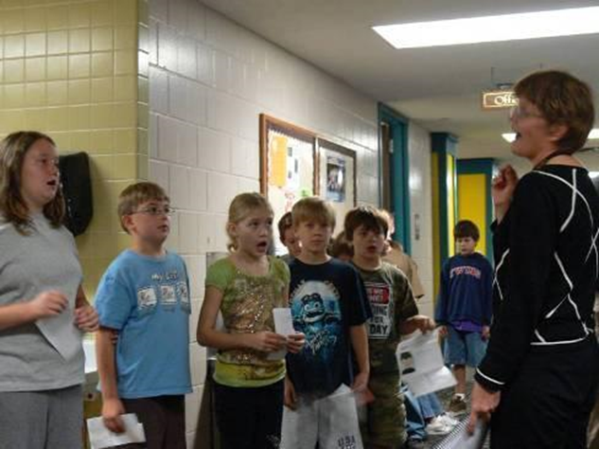
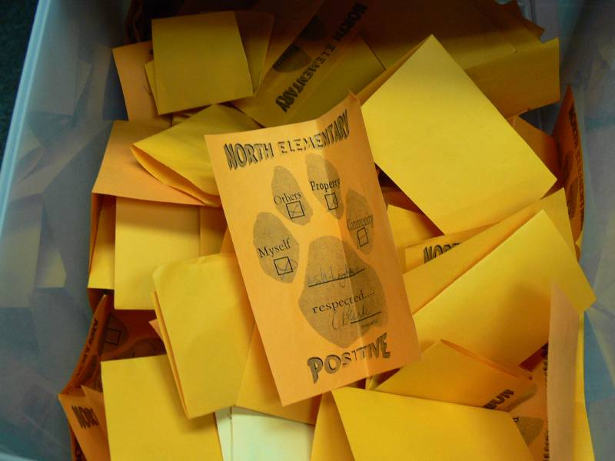
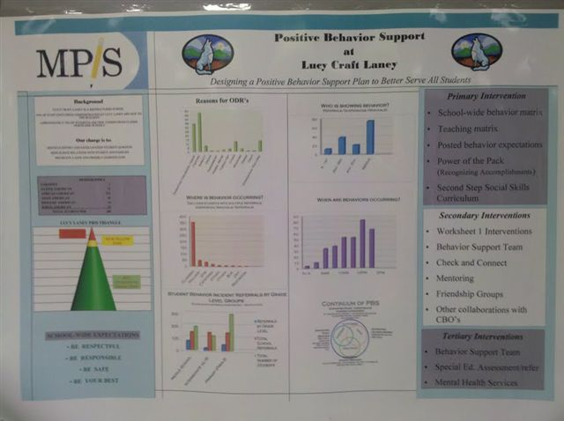
Definition in Practice
School Leadership Team that supports all staff, students, and families with:
3-5 positive expectations, taught and practiced
Acknowledgement and feedback system
Consistent and specialized supports
Continuum of interventions for all
to support Behavior
Data-based decision making
Team-Based Approach
Source: https://www.revisor.mn.gov/laws/?id=5&year=2017&type=1#laws.2.26.0
Notes:
From the bike to the statute – this is what it looks like with MN examples.

Slide 6
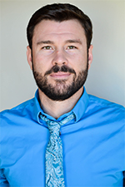

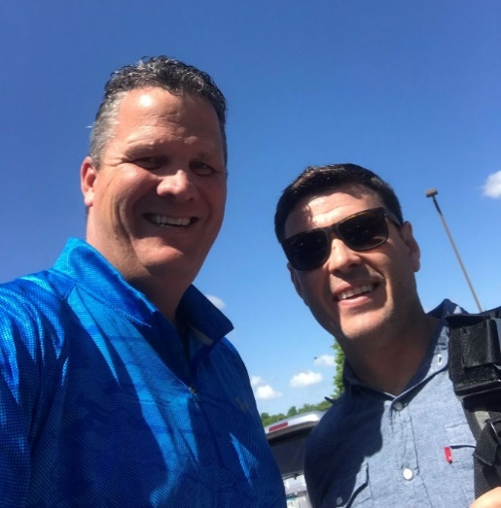
Positive Greetings at the Door
Positive Greetings at the Door: Evaluation of a Low-Cost, High-Yield Proactive Classroom Management Strategy, Clayton R. Cook et al. is the most read JPBI article in last 6 months!
https://journals.sagepub.com/doi/full/10.1177/1098300717753831
Notes:
Dr. Cook (school psychology) specializes in school-based mental health, investigating practices that facilitate the implementation of a multi-tiered system of support (MTSS). His research focuses on helping practitioners (teachers, administrators, mental health providers) improve the delivery of school-based services to youth in schools, as demonstrated by a range of improved outcomes, including gains in academic achievement, improvements in social-emotional functioning, reductions in punitive disciplinary practices, and remediation of disparities for minority youth.

Slide 7
Conclusion
This study found that classrooms with teachers trained and supported to use the Positive Greetings at the Door (PGD) strategy were associated with diminished Disruptive Behaviors (DB) and greater Academic Engaged Time (AET) than those in the control group
  Extra 12-min of on-task behavior per instructional hour or an additional hour of engagement over the course of a 5-hr instructional day
  The PGD strategy could potentially result in gains of several more hours of additional academic engagement over the course of the academic year, which could produce significant improvements in actual academic achievement
PGD may serve to enhance teacher–student relationships, thereby creating a more positive classroom climate for all.
Notes:
As hypothesized, this experimental study found that classrooms in which teachers received training and support to use the PGD strategy were associated with diminished Disruptive Behavior (DB) and greater academic engaged time (AET) than those in the attention control
Extra 12 min of on-task behavior per instructional hour or an additional hour of engagement over the course of a 5-hr instructional day
On a larger scale, use of the PGD strategy could potentially result in gains of several more hours of additional academic engagement over the course of the academic year, which could produce significant improvements in actual academic achievement
PGD may serve to enhance teacher–student relationships, thereby creating a more positive classroom climate for all
In addition, preservice preparation programs should consider providing training on evidence-based behavior management strategies, such as the PGD, that are relatively quick, easy to implement, and effective.

Slide 8
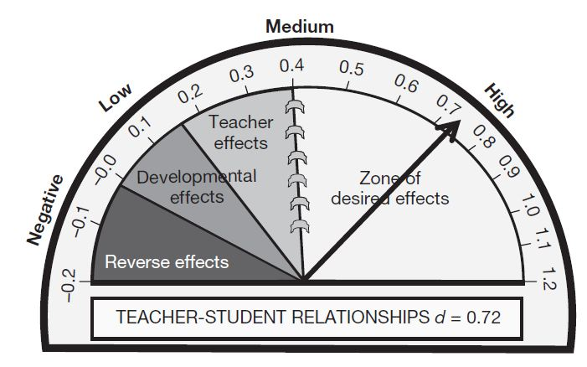
Student –Teacher Relationships
One stable and committed adult relationship
  National Scientific Council on the Developing Child (2015). Supportive Relationships and Active Skill-Building Strengthen the Foundations of Resilience. Harvard University.
Teacher-Student Relationship has a .72 effect size on student learning
Average effect size of all interventions studied was .40
Hattie. J. (2009). Visible learning: A synthesis of over 800 meta-analyses relating to achievement. London: Routledge.

Slide 9

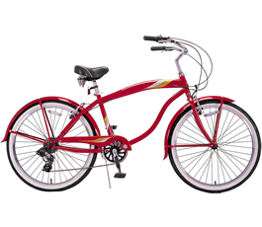
PBIS Framework
Coaching
School Team
Data
PBIS
Evidence-based
Interventions
School Principal
Implementation
Adapted from Don Kincaid
Notes:
From KM keynote at the implementers forum –really a great analogy-once you learn how to ride a bike you never fit-taking the training wheels off
This is about the analogy of the bike and the MN statute. Number 6 in statute is using a team-based approach to support effective implementation , monitor progress, and evaluate outcomes.
Bike frame = PBIS as framework
Seat= school team sits in drivers seat
Steering= coaches make adjustments along the way
Gears/derailleur= principal controls resources (changes gears)
Pedals= implementation is what powers the work
Wheel= evidence based practice (can be different types of wheels)
Map= data is what lets you know where your heading

Slide 10
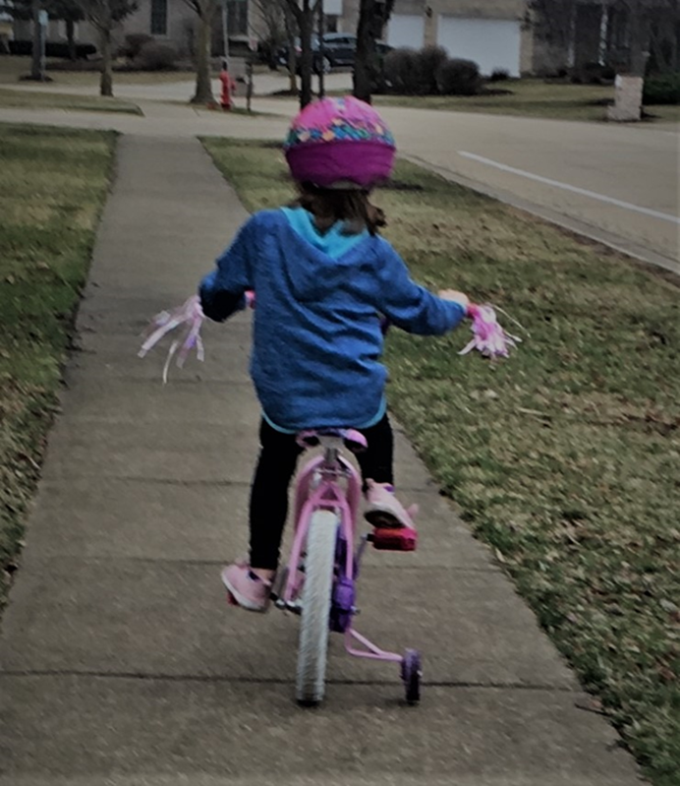
Riding Into Sustainability
.
Training wheels are coming off
  Know where you are headed
  Contact your Regional Coordinator
  Resources & support are available
Notes:
Note that there is only 1 training wheel on,. Almost ready to ride on their own but there are still supports available.

Slide 11
TFI Progress & Sustainability

Slide 12
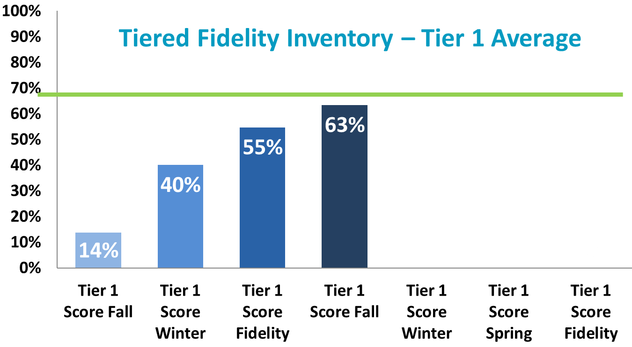
TFI NRIP Cohort 14A

Slide 13
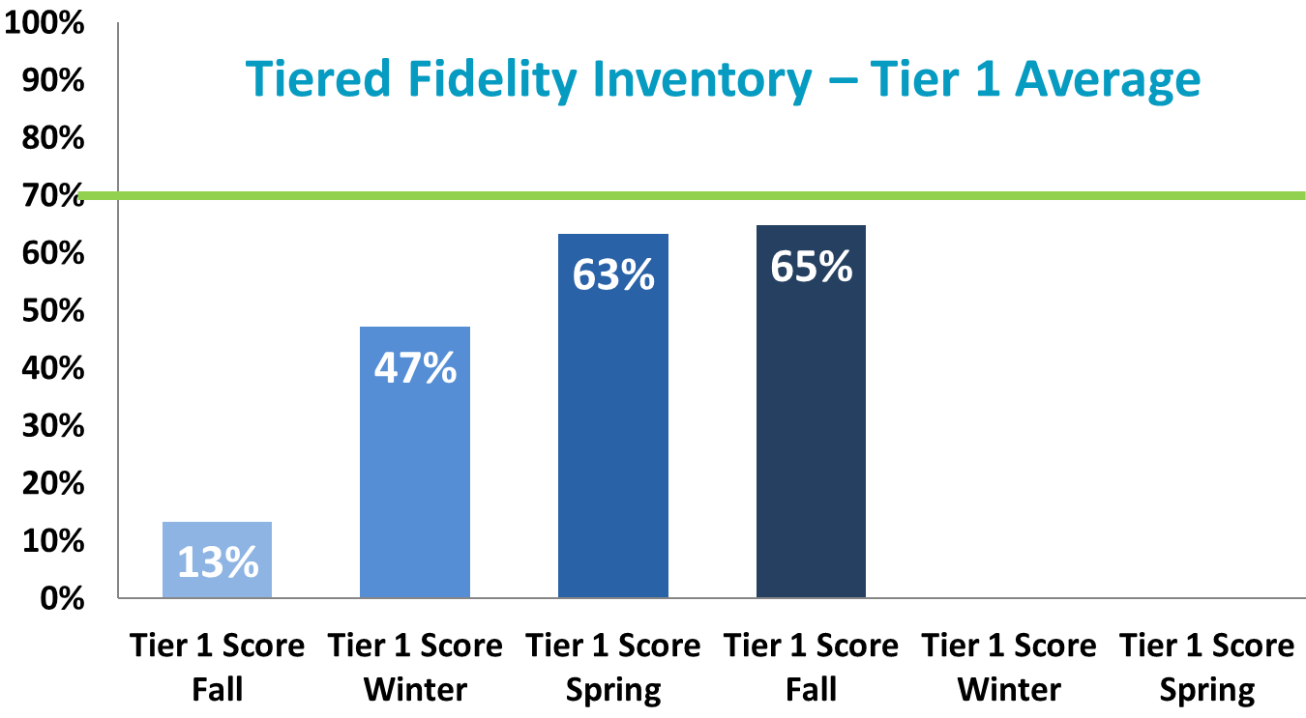
TFI NRIP Cohort 14B

Slide 14
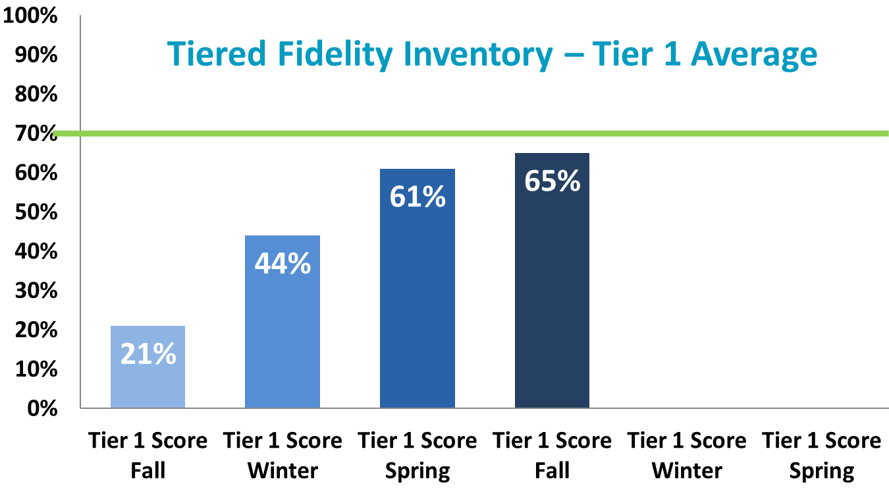
TFI MRIP Cohort 14

Slide 15
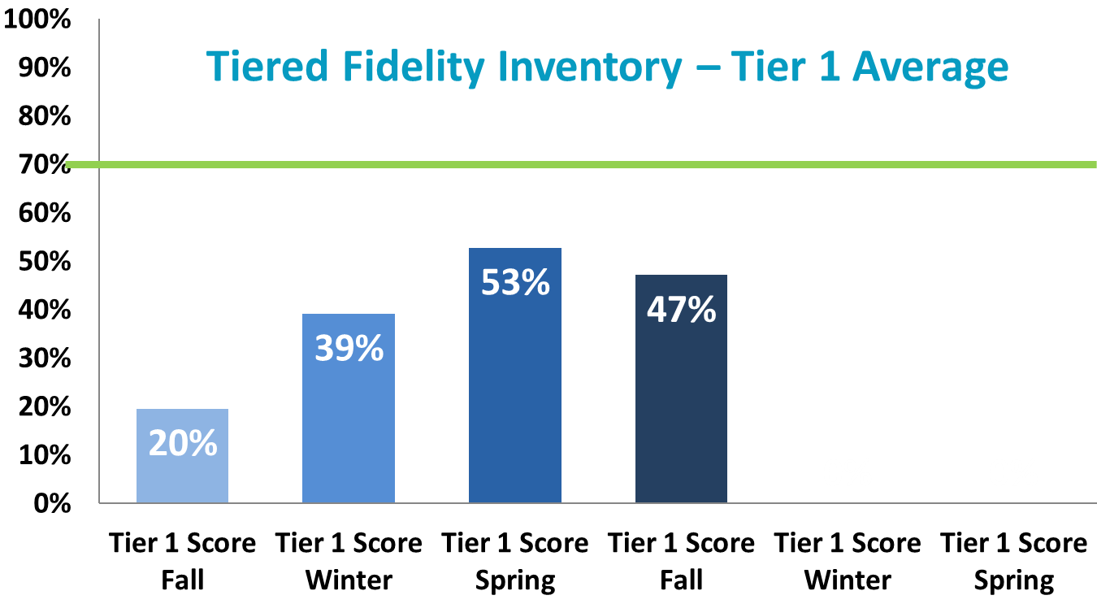
TFI SRIP Cohort 14

Slide 16
… “(6) using a team-based approach to support effective implementation, monitor progress, and evaluate outcomes.”
Few
Supports for
All Students
Some
Notes:
This slide speaks to sustainability. The TFI has been available now for 5 years and this is a quick look at how schools are using the TFI to measure fidelity of implementation across the Tiers. As emphasized in training it is important not to lose sight of fidelity of Tier 1 so that it is strong to support Tier 2 and 3. Number one factor in sustainability is Team Sharing of Data!
Year 1 T1 ave= 77.4% T2 ave = 64.5% T3 ave= 61.8% n= 148
Year 2 T1 ave= 79.2% T2 ave = 73.5% T3 ave= 69.5% n= 148
Year 3 T1 ave= 82.5% T2 ave = 78.4% T3 ave= 76.9% n= 80
Year 4 T1 ave= 85.1% T2 ave = 82.6% T3 ave= 79.3% n= 21
Year 5 T1 ave= 82.4% T2 ave = 82.5% T3 ave= 82.4% n= 11

Slide 17
Data Calendar At-A Glance
Notes:
Reminder for sustainability
After training regional coordinators can help you!
57 Cohort 11 school teams
49 completed a TFI
86% completed TFI
69% average TFI score
641 Cohort trained schools (Cohorts 1-13)
339 completed a fidelity measure
53% completed a fidelity measure
69 non-cohort trained schools completed a TFI
100% DOABLE to measure and sustain PBIS after training is completed!!!

Slide 18
PBIS Leadership Forum

Slide 19

Implementers Forum 2019
This two-day forum for school, state, district, and regional Leadership Teams and other professionals has been designed to help increase the effectiveness of PBIS implementation.
https://www.pbis.org/conference-and-presentations/pbis-leadership-forum
Notes:
Links and examples from the Forum even if you cannot attend in person
Power points are listed and contacts are listed in presentations
Great resource!

Slide 20
Implementers Forum 2019 Strand Introductions
Equity
Family Engagement
High School
Juvenile Justice
Mental Health
PBIS Foundations
Tier 2
Tier 3
Notes:
Here is a list of the strands that part of the Forum with a link to the introductions.
Preview of strands that were covered with resources and videos

Slide 21
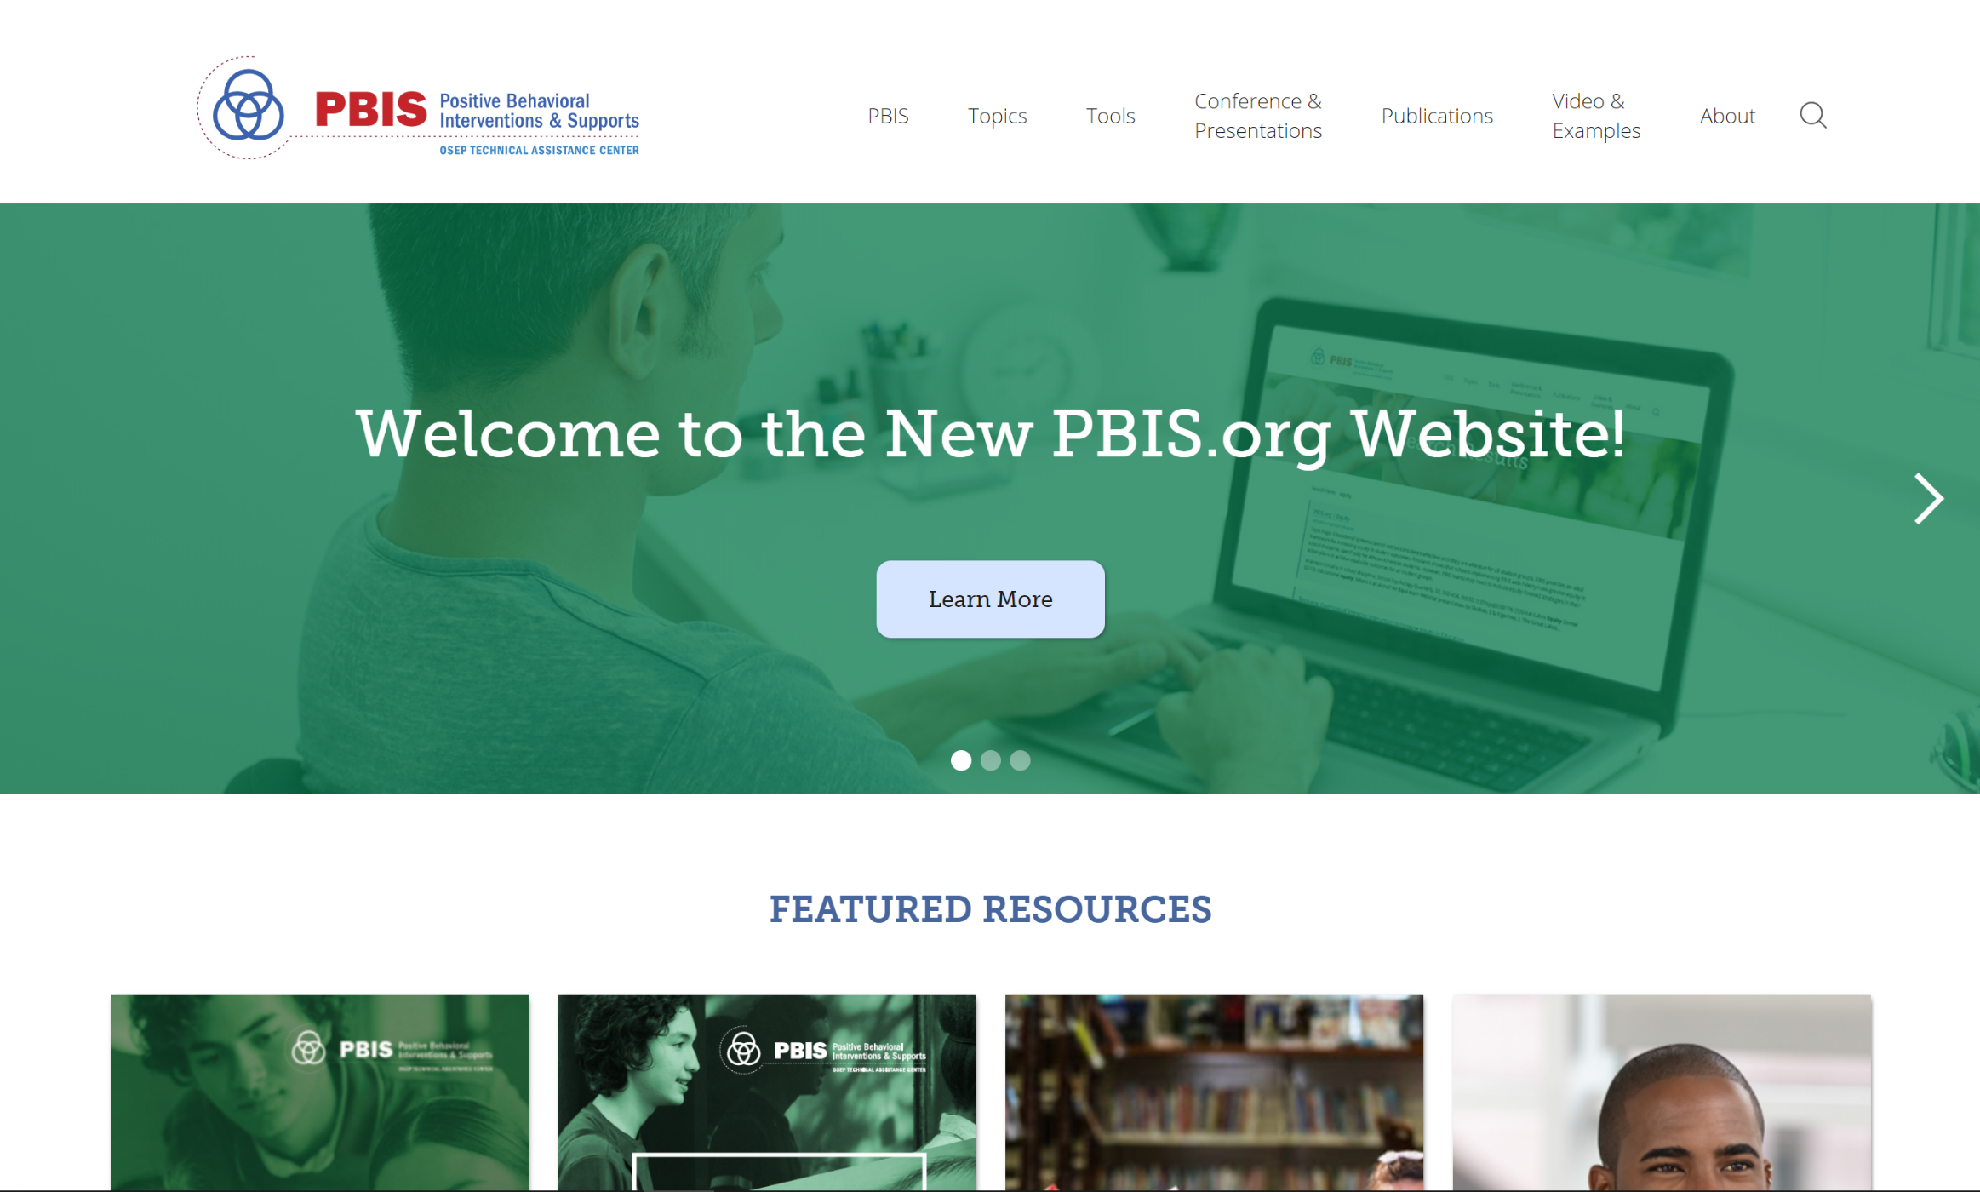
PBIS.org
Notes:
System to support the way it works – positive specific feedback
Not quite ready for Apple IOS
UPDATE to main page and add link

Slide 22

Get Positive!
Download here:
  https://play.google.com/store/apps/details?id=edu.uoregon.emberex_bpositive
iOS version coming soon

Slide 23
News & Save the Dates

Slide 24
Cohort 16 Application
Application is now available for new schools to join cohort training
  Please help spread the word
Link: Minnesota PBIS website (http://pbismn.org/getting-started/application-for-school-training.php)
Deadline: Monday, February 10, 2020

Slide 25
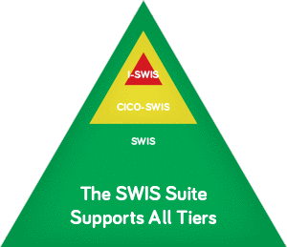
SWIS Facilitator Training
The reports available within SWIS allow teams to:
    Review school-wide referral patterns
    Define behavior patterns in greater detail
Training dates to be determined
Notes:
There will be SWIS facilitator trainings in the Metro and in the North with dates yet to be determined. South already held a training
Through SWIS, school staff enter office discipline referrals online. The data are summarized to provide information about individual students, groups of students, or the entire student body over any time period.
The reports available within SWIS allow teams to do precision problem-solving:
Review school-wide referral patterns: The five basic reports in SWIS frame the context within which problem behaviors occur at school helping teams to answer these questions:
How often do referrals occur?
What problem behaviors occur most frequently in our building?
Where are problem behaviors most likely to occur?
When are problem behaviors most likely to occur?
Which students are involved in referrals?
Define behavior patterns in greater detail: Eight other reports allow teams to dive into the data, getting more detailed information about specific questions related to the overall school-wide patterns. Using these reports, teams can look at disproportionality by ethnicity, detailed information about individual students’ referral patterns and year-end reports to guide action planning for the upcoming school year.

Slide 26


2020 Collaborators Forum
2020 Collaborators Forum
Tuesday, April 14, 2020
Minnesota Department of Education – Roseville, MN
Satellite Sites to be determined
mnpsp.org/mnpbs
The Collaborators Forum is an event for people interested in Positive Behavior Supports
across settings and the lifespan in Minnesota.
Notes:
Unique opportunity outside of school teams to see other facilities that are doing Positive behavior supports across the life-span

Slide 27


2020 Minnesota PBIS Institute and Film Festival
Save-the-dates for June 16-17, 2020 at MDE - Roseville, MN
Request for proposals for breakout sessions and films will appear in the winter
Submission forms and presentations from previous institutes at Minnesota PBIS Summer Institute

Slide 28

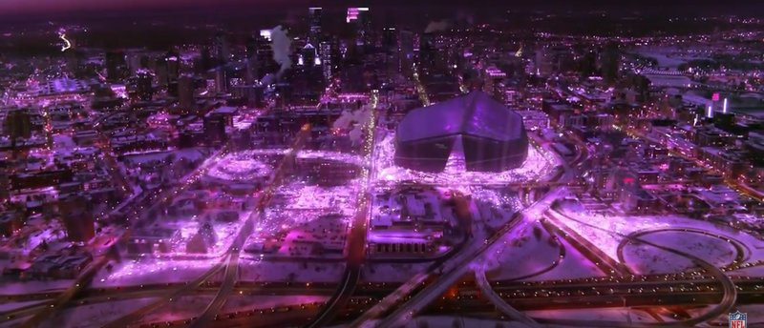
2021 APBS Conference Minneapolis
APBS Conference 2021 March 17th-20th Hyatt Regency - Minneapolis
There is no text here
MN PBS Twitter Feed about the 2021 APBS Conference in Minneapolis

Slide 29
Northern Regional MDE Contacts
Mary Hunt
Mary.Hunt@state.mn.us
651-582-8676
Erin Farrell
Erin.Farrell@state.mn.us
651-582-8578
Eric Kloos
Eric.Kloos@state.mn.us
651-582-8268

Slide 30
Metro Regional
MDE Regional Contacts
Ellen Nacik
Ellen.Nacik@state.mn.us
651-582-8665
Becky Nies
Rebecca.Nies@state.mn.us
651-582-8648
Eric Kloos
Eric.Kloos@state.mn.us
651-582-8268

Slide 31
Southern Regional MDE Contacts
Janet Christensen
Janet.Christensen@state.mn.us
651-582-8513
Garrett Petrie
Garrett.Petrie@state.mn.us
651-582-8396
Eric Kloos
Eric.Kloos@state.mn.us
651-582-8268

Slide 32
Thank you!
Minnesota Department of Education
PBIS Management Team
mde.pbis@state.mn.us

